Slide 1
Analysis of the Housing Market in California
Iuliia Bolgova
julibolg@gmail.com

Slide 2
The purpose of this analysis
To study the factors affecting the cost of housing in California

Slide 3
Data Preprocessing
The data set contains
9
columns
20,640
rows
0
NaN

Slide 4
Columns
MedInc: average income in the area (in tens of thousands of dollars)
HouseAge: age of houses in the area
AveRooms: average number of rooms in the house
AveBedrms: average number of bedrooms in the house
Population: population of the district
AveOccup: average number of tenants per house
Latitude: latitude of the district
Longitude: length of the area
MedHouseVal: the median cost of a house in the area (in hundreds of thousands of dollars)

Slide 5
Columns
MedInc: average income in the area (in tens of thousands of dollars)
HouseAge: age of houses in the area
AveRooms: average number of rooms in the house
AveBedrms: average number of bedrooms in the house
Population: population of the district
AveOccup: average number of tenants per house
Latitude: latitude of the district
Longitude: length of the area
MedHouseVal: the median cost of a house in the area (in hundreds of thousands of dollars)

Slide 6
Columns
MedInc: average income in the area (in tens of thousands of dollars)
HouseAge: age of houses in the area
AveRooms: average number of rooms in the house
AveBedrms: average number of bedrooms in the house
Population: population of the district
AveOccup: average number of tenants per house
Latitude: latitude of the district
Longitude: length of the area
MedHouseVal: the median cost of a house in the area (in hundreds of thousands of dollars)

Slide 7
Columns
MedInc: average income in the area (in tens of thousands of dollars)
HouseAge: age of houses in the area
AveRooms: average number of rooms in the house
AveBedrms: average number of bedrooms in the house
Population: population of the district
AveOccup: average number of tenants per house
Latitude: latitude of the district
Longitude: length of the area
MedHouseVal: the median cost of a house in the area (in hundreds of thousands of dollars)

Slide 8
Columns
MedInc: average income in the area (in tens of thousands of dollars)
HouseAge: age of houses in the area
AveRooms: average number of rooms in the house
AveBedrms: average number of bedrooms in the house
Population: population of the district
AveOccup: average number of tenants per house
Latitude: latitude of the district
Longitude: length of the area
MedHouseVal: the median cost of a house in the area (in hundreds of thousands of dollars)

Slide 9
Columns
MedInc: average income in the area (in tens of thousands of dollars)
HouseAge: age of houses in the area
AveRooms: average number of rooms in the house
AveBedrms: average number of bedrooms in the house
Population: population of the district
AveOccup: average number of tenants per house
Latitude: latitude of the district
Longitude: length of the area
MedHouseVal: the median cost of a house in the area (in hundreds of thousands of dollars)

Slide 10
Columns
MedInc: average income in the area (in tens of thousands of dollars)
HouseAge: age of houses in the area
AveRooms: average number of rooms in the house
AveBedrms: average number of bedrooms in the house
Population: population of the district
AveOccup: average number of tenants per house
Latitude: latitude of the district
Longitude: length of the area
MedHouseVal: the median cost of a house in the area (in hundreds of thousands of dollars)

Slide 11
Columns
MedInc: average income in the area (in tens of thousands of dollars)
HouseAge: age of houses in the area
AveRooms: average number of rooms in the house
AveBedrms: average number of bedrooms in the house
Population: population of the district
AveOccup: average number of tenants per house
Latitude: latitude of the district
Longitude: length of the area
MedHouseVal: the median cost of a house in the area (in hundreds of thousands of dollars)

Slide 12
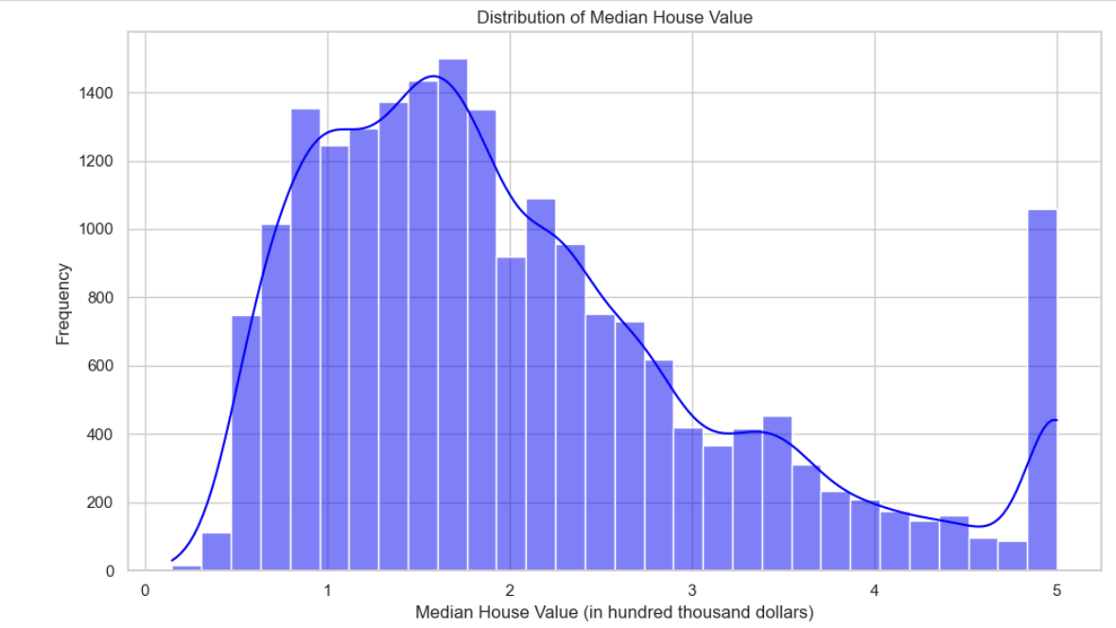
Distribution of the average cost of houses
Most houses have a cost below $500,000 (5 in hundreds of thousands of dollars).
The distribution of value is beveled to the right, which indicates the presence of a small number of houses with very high cost

Slide 13
Distribution of the average cost of houses
Most houses have a cost below $500,000 (5 in hundreds of thousands of dollars).
The distribution of value is beveled to the right, which indicates the presence of a small number of houses with very high cost

Slide 14
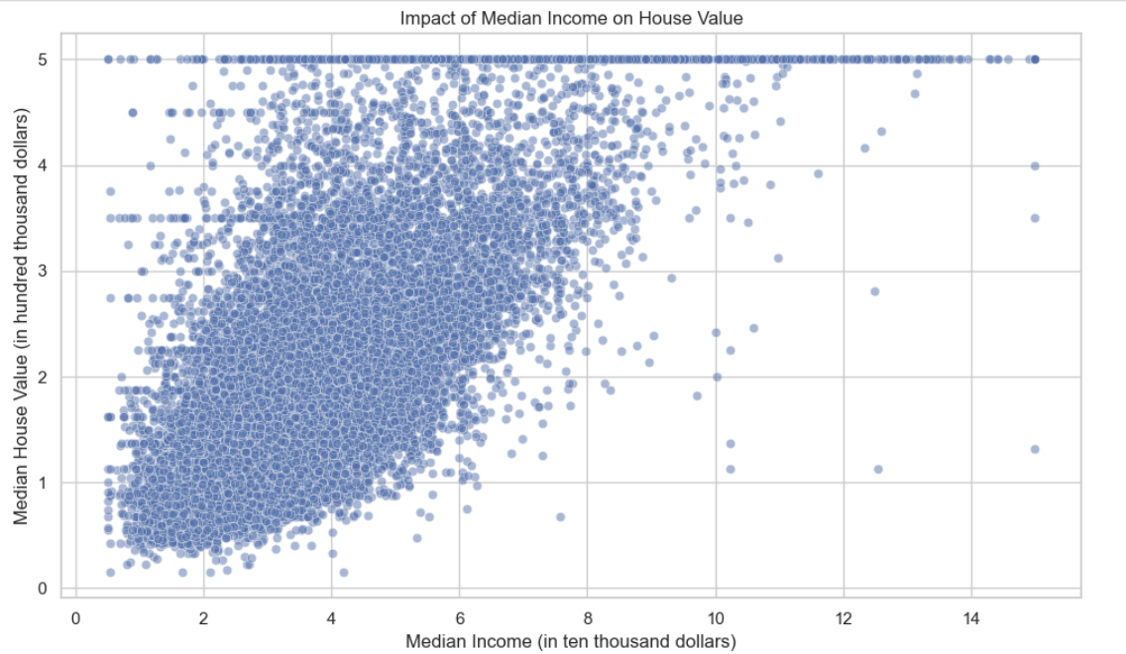
The impact of average income on the cost of the house
Positive correlation between average income and house value.
This means that higher-income areas tend to have higher housing prices

Slide 15
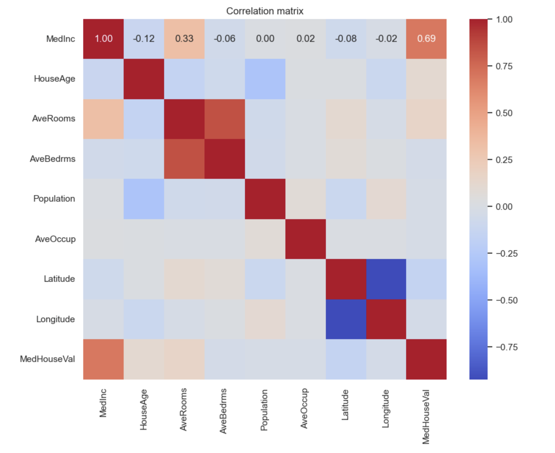
Correlation Matrix
The average income has a high positive correlation with the cost of housing
The number of rooms is also positively correlated with the cost of housing.
The age of houses has a weak negative correlation with the cost of housing

Slide 16
Correlation Matrix
The average income has a high positive correlation with the cost of housing
The number of rooms is also positively correlated with the cost of housing.
The age of houses has a weak negative correlation with the cost of housing

Slide 17
Correlation Matrix
The average income has a high positive correlation with the cost of housing
The number of rooms is also positively correlated with the cost of housing.
The age of houses has a weak negative correlation with the cost of housing

Slide 18
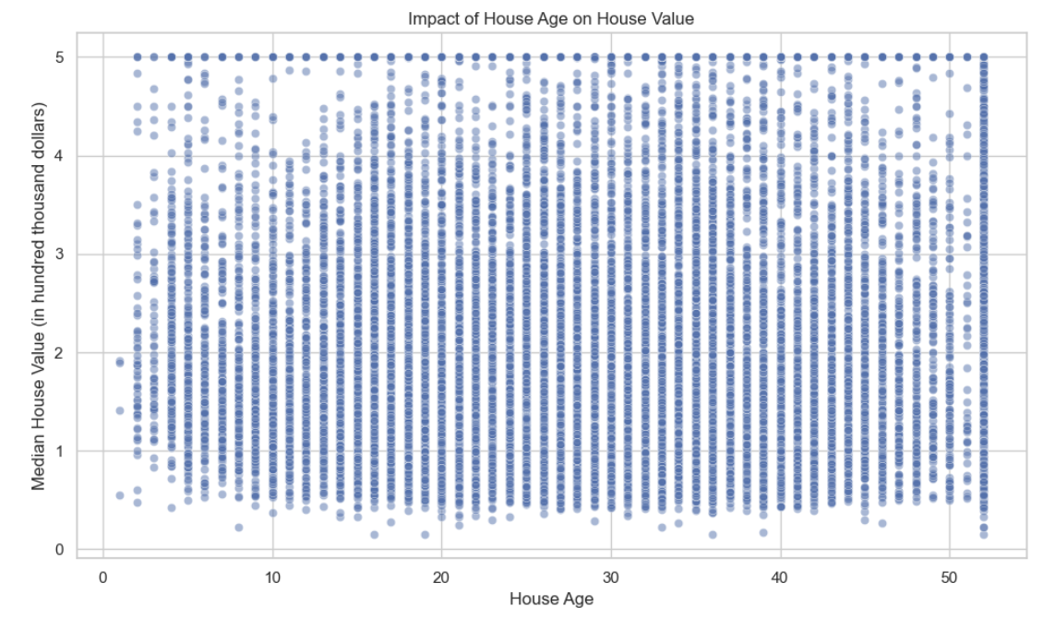
Influence of the age of houses on the cost
There is no clear relationship between the age of the houses and their cost.
However, it can be noticed that the cost of houses over the age of 50 may be slightly lower

Slide 19
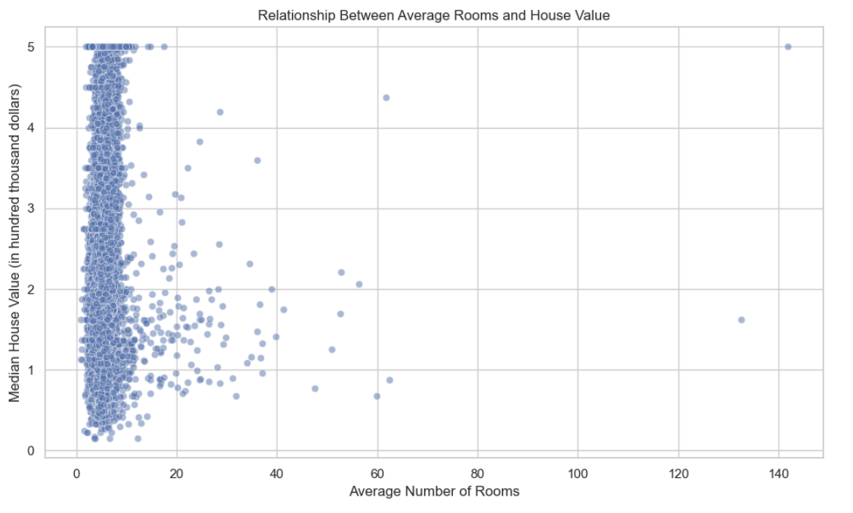
Relationship between the number of rooms and cost
The average cost of the house increases with the increase in the number of rooms.
However, from a certain point in time, adding rooms does not lead to a significant increase in the cost

Slide 20
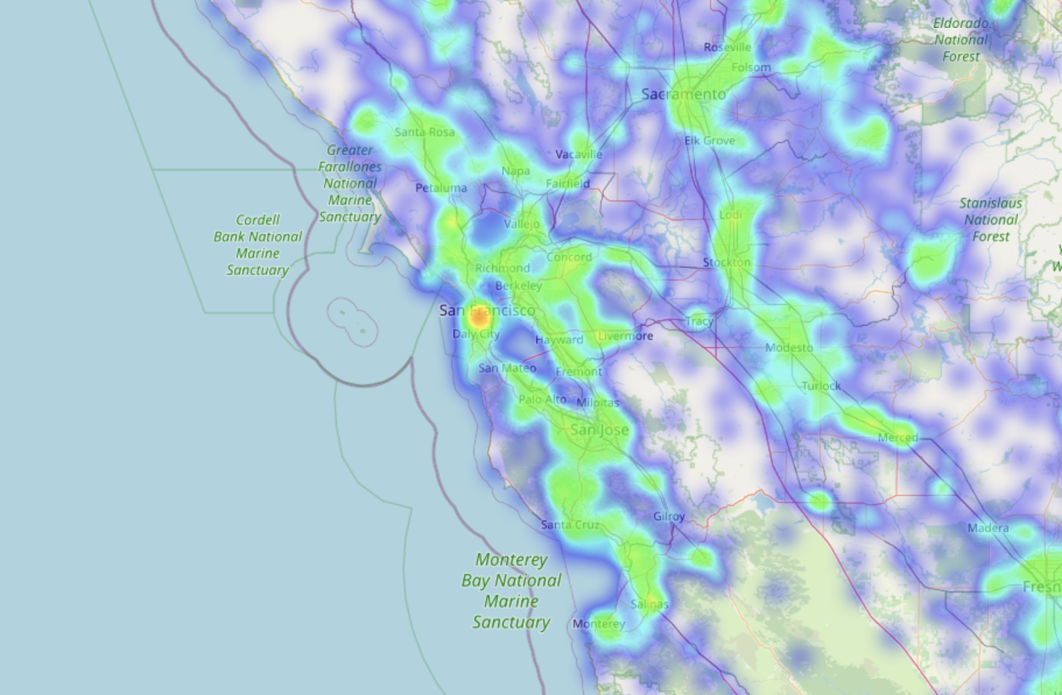
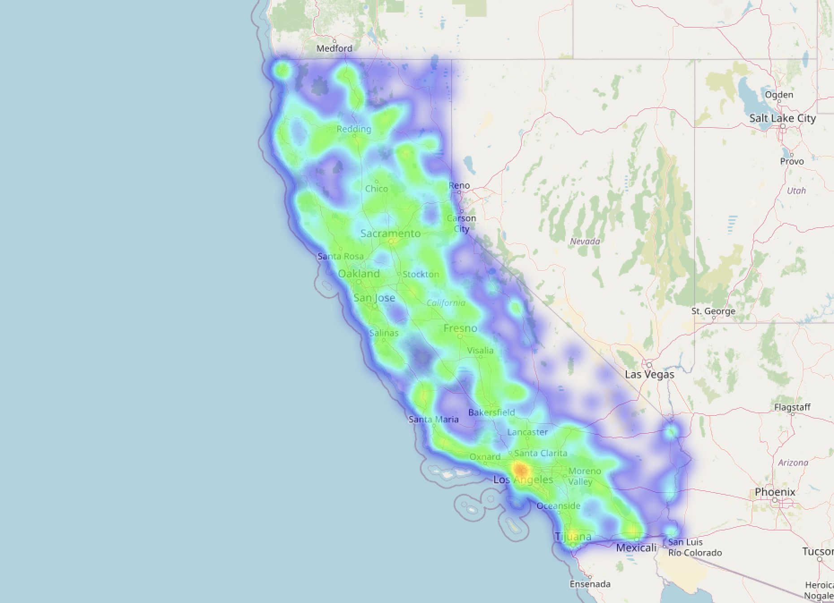
Geographical distribution of house prices
Los
Angeles
San Francisco
Houses in coastal areas of California, such as San Francisco and Los Angeles, have a higher cost than other areas

Slide 21
Main conclusions:
Average income is an important factor affecting the cost of housing.
Geographical location plays a significant role in determining the value of houses.
The number of rooms and the age of houses also affect their cost, but to a lesser extent.

Slide 22
Main conclusions:
Average income is an important factor affecting the cost of housing.
Geographical location plays a significant role in determining the value of houses.
The number of rooms and the age of houses also affect their cost, but to a lesser extent.

Slide 23
Main conclusions:
Average income is an important factor affecting the cost of housing.
Geographical location plays a significant role in determining the value of houses.
The number of rooms and the age of houses also affect their cost, but to a lesser extent.

Slide 24
Conclusion - Further steps:
Conduct a more detailed analysis, taking into account additional factors such as the level of education, availability of jobs, etc.
Investigate long-term trends in housing prices
Application of linear regression to predict the cost of housing based on average income, age of houses and other factors.

Slide 25
Conclusion - Further steps:
Application of cluster analysis to identify areas with similar characteristics.
Use of heat maps to visualize the distribution of housing cost and income by region

Slide 26
Thanks!
ANY QUESTIONS?

